Slide 1
QUOTATION
Notes:
Ready

Slide 2
About
Askona is an internationally recognized brand that is expert in creating personalized space and environment for healthy sleep.
Our mission is to make people happy and healthy by giving them strength and energy to make their dreams come true.
Notes:
Ready

Slide 3
About
ASKONA is Russia’s largest vertically integrated retailer that specializes in manufacturing the entire range of products for healthy sleep: mattresses, beds, sofas, modular furniture, gadgets and other accessories.
PRIMARY PRODUCTION
Polyurethane foam plant
Polyester batting plant
Coir plant
Pocket spring unit manufacturing
Tape and cardboard plant
MANUFACTURING OF GOODS
Mattress factory
Bed factory
Sofa factory
Textile factory
Modular furniture factory
SALES OF PRODUCTS
Own retail chain
Well-developed dealer network
Extensive distribution network
Export
Notes:
Ready

Slide 4
Our Manufacturing
MANUFACTURING AND LOGISTICS
The largest automated manufacturing in the Eastern Europe
Total manufacturing area is over 160,000 square metres
5S control and quality system is integrated in the company
1,900,000
82,000
171,000
970,000
PER YEAR
mattresses
sofas
beds
blankets and pillows
Vertically integrated manufacturing with direct primary and spare parts production
9 manufacturing areas located in Kovrov, Vladimir and Novosibirsk
Headcount of production employees exceeds 4,000.
IWAY and QWAY are certified according to the IKEA International Standard
Notes:
Ready

Slide 5
Products and Services
In-house quality laboratory
The only laboratory in Russia where mattresses are tested
for strength, durability and
other parameters.
Research in the field of somnology
Together with doctors, we study the influence of sleep on human health and the quality of life. This research is considered when manufacturing goods for healthy sleep.
Researches of consumer preferences
Regular marketing research allows offering the customer individual integrated solutions for comfortable and healthy sleep.
The right pillow works like a charm
More than 40 regional warehouses with goods always on stock
Drawing up and maintaining the stock matrix
Automated order recording system
Service Desk to provide support at all stages of shipment
Corporate car fleet
Notes:
Ready

Slide 6
Competitive advantages
Unique material combinations
Use of innovative and time-proven materials.
Vast range of models
Anyone regardless of occupation, income level, interests or mindset, can find a suitable mattress model.
Comfort and relaxation
The best indicators of anatomicity, impregnation and comfort systems increase the relaxation effect.
Safe materials
Only the best materials that have passed the most stringent control are used. Environmentally friendly and hypoallergic filling materials. All materials have passed laboratory testing.
Aesthetic appearance
All design elements are selected to match perfectly.
Quality
All models are carefully assembled on the best conveyor in Russia. Only quality materials are used for assembly operations. At the stage of assembly, a mattress is subject to examination and measurement no less than 5 times!
Price policy
Owing to the leading positions in the market and huge volumes of parts procurement, we can offer better prices than our competitors.
Notes:
Ready

Slide 7
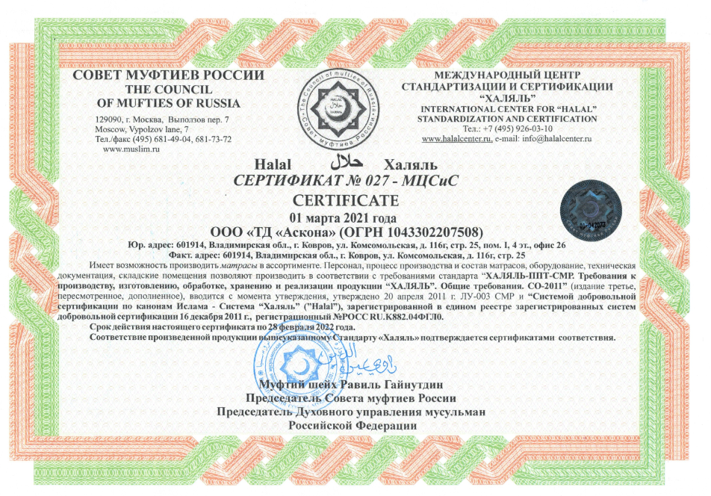
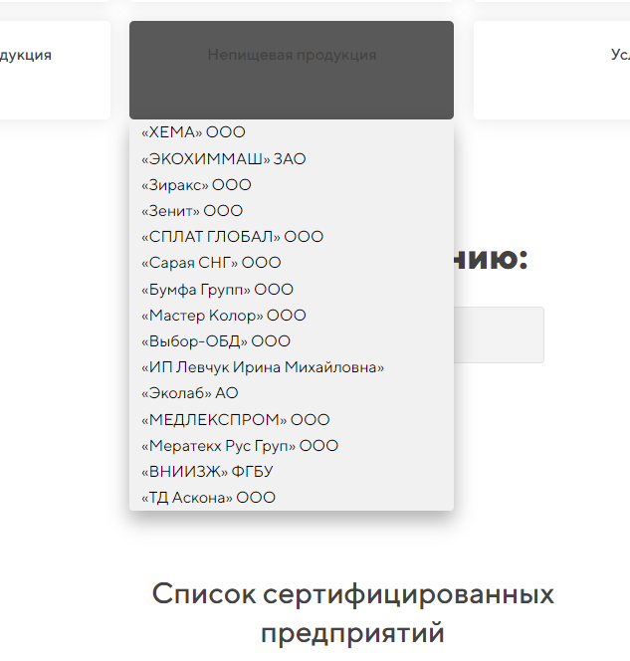
Halal Certification
Benefits of Halal Products
1. Permissibility Any Muslim who believes in God and takes care of their Soul and body should only use the products that are permitted. Halal products certainly have many other benefits for people of any religions and beliefs, but for the Muslim using them is essential. Halal products should not contain any prohibited elements, such as those of animal origin.
2. Safety Additional control over Halal certified products is a guarantee of safety for many consumers regardless of their confession. That’s why Halal products are in great demand even in the countries where the Muslim do not constitute the majority of population, i.e. among the people of other confessions
Halal Certification
document that proves that the products meet the requirements of the Halal standards of the Russian Council of Muftis
EXCLUSIVE! It’s the first time in Russia when Halal certificate is obtained for mattresses
Askona is listed at
https://halalcenter.ru/reestr/
List of certified enterprises
Notes:
Ready

Slide 8
HALAL
Quantity of models
5 mattresses
Firmness
mostly firm
Load
up to 90 kg for a DILEK mattress
up to 110 kg for a KONFOR mattress
over 140 kg for all other mattresses
Warranty
3 years for a DILEK mattress
5 years for a KONFOR mattress
25 years for all other mattresses
Notes:
Ready

Slide 9
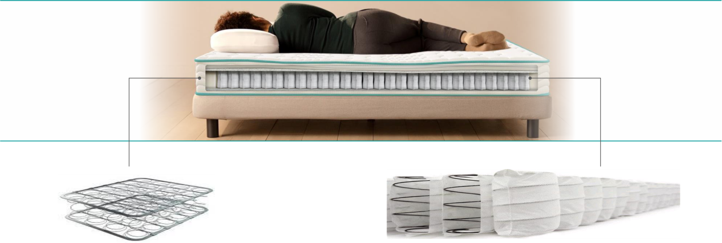
HALAL. Mattress framework
One of the most important elements of any mattress is a spring system. It determines the level of comfort for rest and recuperation during sleep.
Bonnel Spring System
Pocket Spring System
A classical spring unit made of interconnected 5-turn Bonnel springs. The unit ensures even load distribution without contact between spring coils
h – 13 cm
wire diam. 2.1 mm
Benefits:
even load distribution across the entire horizontal surface of the mattress
local support of the spine
perfect ventilation and hygiene
A spring unit consists of cylindrical springs each placed in an enclosed pocket. Compression of each spring in a unit occurs independently of adjacent springs
h – 12 cm (wire diam. 1.7 mm)
h – 15 cm, 18 cm (wire diam. 1.9 mm)
Benefits:
anatomical spine support
guarantee of point elasticity and correct distribution of human body load
the spine assumes its natural position
reduction of muscle tension
Notes:
Ready

Slide 10
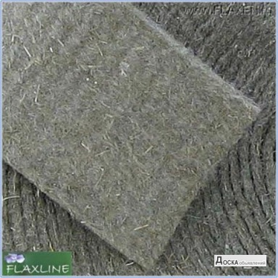
HALAL. Mattress protection
It’s a layer of materials that cover rigid parts of the mattress and prevent ripping and deformation of the product from the inside.
Bi-coconut is a fiber that consists of coconut and synthetic fibers. After special processing it is used as mattress filling. The hygienic, moisture-proof, air-permeable and anti-bacterial fiber doesn’t cause allergy and is safe for human health. It makes the mattress firm, bouncy, and durable, and ensures proper support of the body during sleep.
White felt is made of cleaned raw cotton. It protects filling materials from damage. The thick and bouncy material is a perfect insulating medium (it separates spring units from the upper layers). It is used to ensure a more even distribution of spring pressure across the body of the sleeping person, add comfort and prolong the lifecycle of a mattress.
Linen fabric is an environmentally friendly organic material with properties that help wick away moisture, absorb adverse ionizing radiation, create healthy microclimate and neutralize odors.
In comparison with the cotton fiber, linen contains much more lignin (a natural polymer that provides firmness), so linen lining is quite firm.
Notes:
Ready

Slide 11
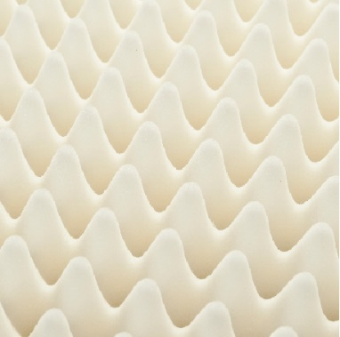
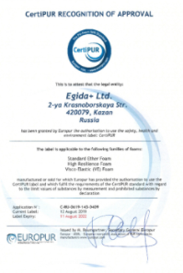
HALAL. Safe foams
A safe foam called Orto Foam certified as per CertiPUR is used in Askona Halal mattresses
СertiPUR Certification
confirms foam safety for the environment and human health
СertiPUR guarantees that the foam:
Is made without any prohibited phthalates (softening agents that cause hazardous substances emission).
Is produced without the use of mercury, lead or other heavy metals that have a negative impact on human health.
Is produced without bromine-based antipyrenes that can cause various chronical diseases in people and pets.
Is produced without using ozone-destroying substances.
Is produced without formaldehydes.
Meets strict requirements in terms of volatile compounds emission in confined spaces.
Notes:
Ready

Slide 12
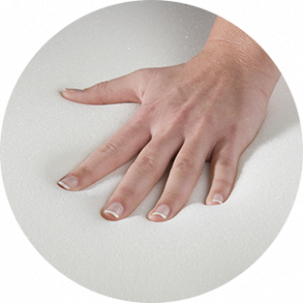
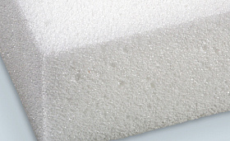
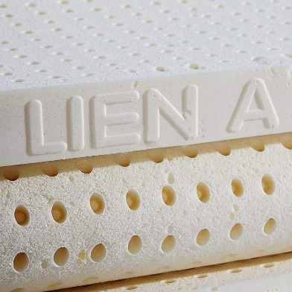
Safe foams
Comfort layers of a mattress ensure good anatomic support and memorize the shape of a human body to distribute the load evenly.
ORTO FOAM
An innovative material with an increased level of bounciness. It has a porous air-permeable structure.
It’s not toxic and doesn’t produce any off-odors.
It retains its properties for a long time and never loses shape.
The foam ensures comfortable sleep.
It’s safe for human health which is confirmed by the CertiPUR Certificate.
High-Density HR Foam
High-density HR foams have special comfort properties and enhanced elasticity
They are perfect for people with different body weights.
Hypoallergic.
High level of comfort.
High air permeability.
Well-balanced microclimate.
Natural latex
Material made of rubberwood juices
High bounciness.
Robustness. Deformation free.
Hygienic.
Hypoallergenic.
Ergonomic.
Quiet.
Improved air permeability.
Thermoregulation.
Notes:
Ready

Slide 13
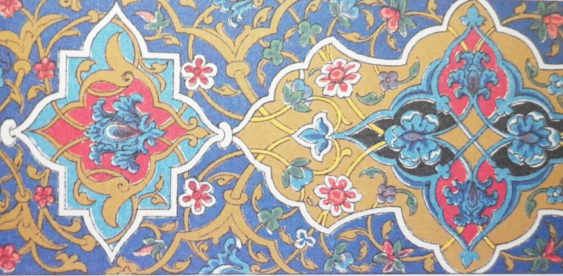
HALAL. Mattress appearance
White color
versatility
white color symbolizes purity and freshness
mattress design does not show through the sheets which improves customer experience
2. Design – point prints are made after the common oriental patterns:
geometric designs prevail
polypetalous flowers
Notes:
Ready

Slide 14
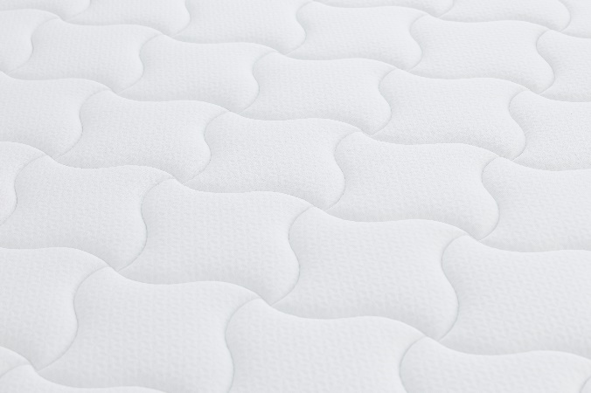
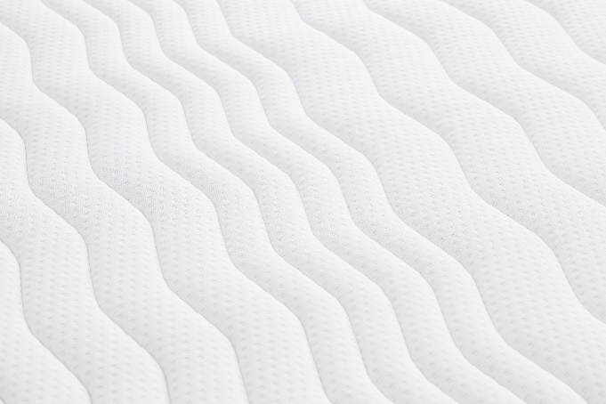
HALAL. Mattress cover
Polyester fiber-based padded jacquard
thick material
the material never pills (does not form rolls)
high durability
no deformation during use
Polyester fiber and ORTO FOAM-based padded knitted fabric
soft
nice to the touch and cozy
fully repeats the shape of a mattress
improves air exchange to ensure overnight sleep at any season
Polyester fiber- and ORTO FOAM-based padded bulky knitted fabric
adds to the softness
ensures healthy and rewarding sleep
air-permeable, wicks away surplus heat which helps enjoy sleep during the entire night without waking up
Point design is a zonal wave:
provides massage-like effect
relaxation of muscles and ligaments
Notes:
Ready

Slide 15
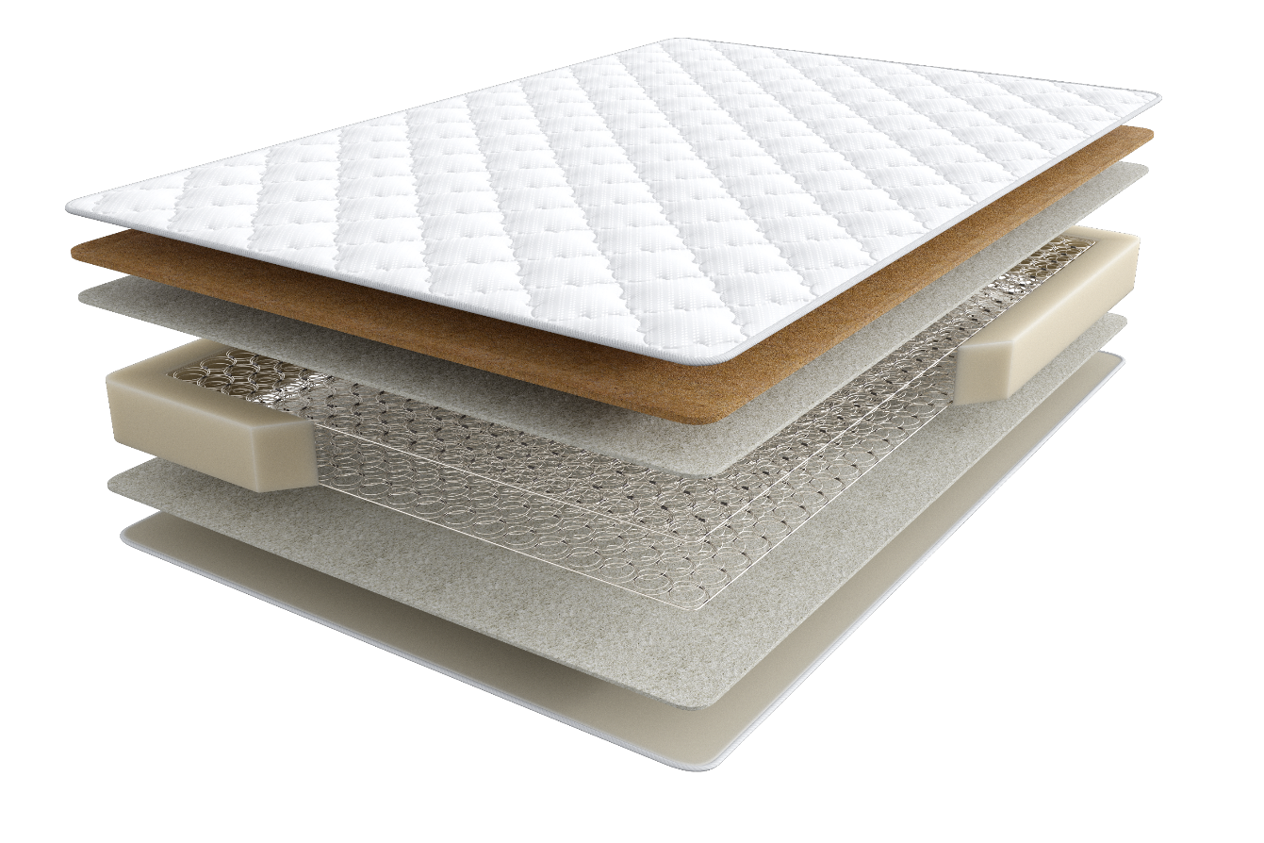
HALAL
DILEK model
- desire, wish (Turk.)
A basic model at a very attractive price. A practical and comfortable mattress
affordable price
natural materials
1
2
Polyester fiber-based padded jacquard
Bi-coconut
White felt
4. Bonnel spring unit, h – 13 cm
5. White felt
6. Mattress edge reinforcement system
6
3
4
5
7
single-sided mattress
height | firmness | load | warranty
16 cm | medium | up to 90 kg | 3 years
Notes:
Ready

Slide 16
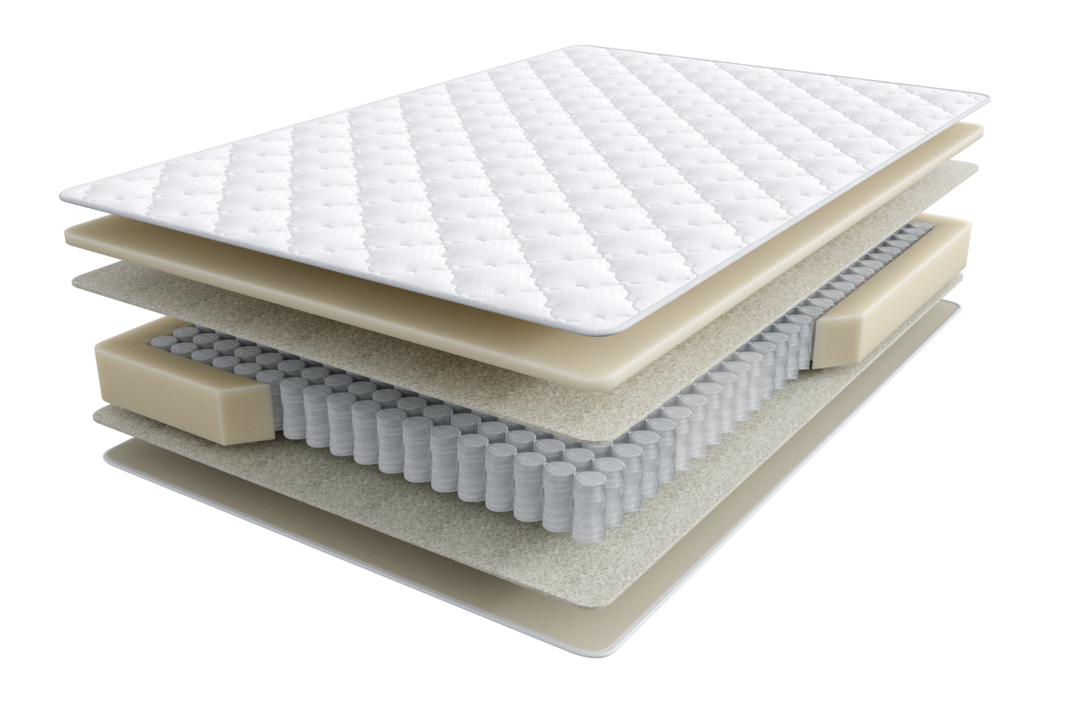
HALAL
KONFOR Model
- comfort (Turk.)
provides effective support for the body during sleep owing to the proper weight distribution across the mattress
anatomicity
comfort
natural materials
1
Polyester fiber-based padded jacquard
Orto Foam
White felt
4. Pocket spring unit, h – 12 cm
5. White felt
6. Mattress edge reinforcement system
7. Polyester fiber-based padded jacquard
2
6
3
4
5
single-sided mattress
7
height | firmness | load | Warranty
16 cm | above medium | up to 110 kg | 5 years

Slide 17
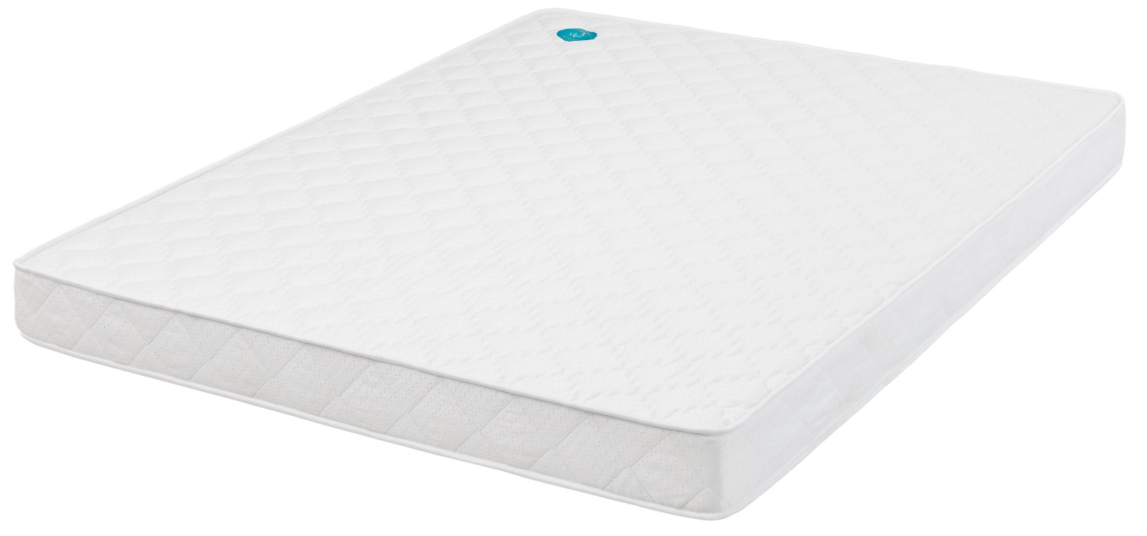
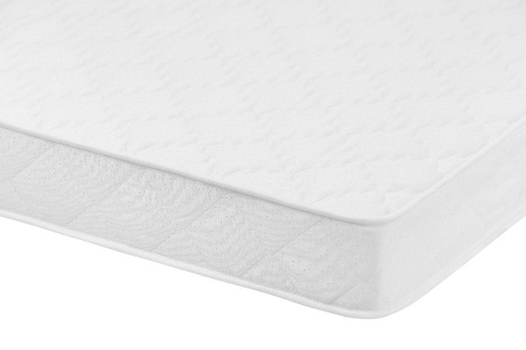
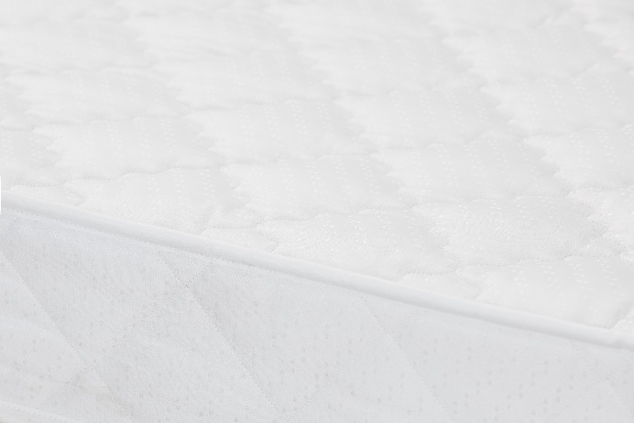
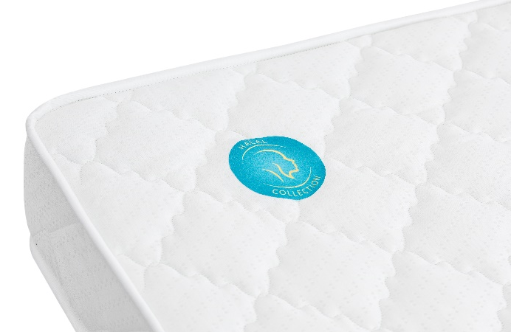
HALAL. Dilek and Konfor mattress appearance
Notes:
Ready

Slide 18
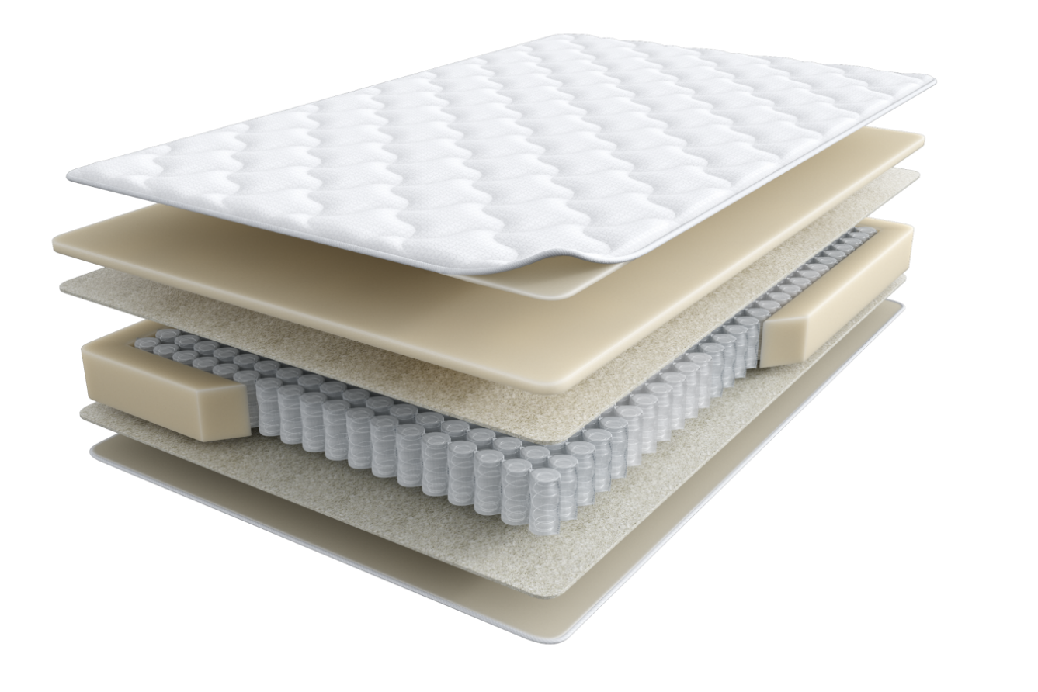
HALAL
DESTEK Model
- support (Turk.)
Sleeping on such a mattress will make you feel comfortable and replenish the energy spent by the body during the day.
anatomicity
comfort
natural materials
Polyester fiber- and highly elastic foam-based padded knitted fabric
Orto Foam
White felt
4. Pocket spring unit, h – 15 cm
5. White felt
6. Mattress edge reinforcement system
7. Polyester fiber-based padded jacquard
1
2
6
3
4
5
single-sided mattress
7
Height | Firmness | load | Warranty
20 cm | high | over 140 kg | 25 years

Slide 19
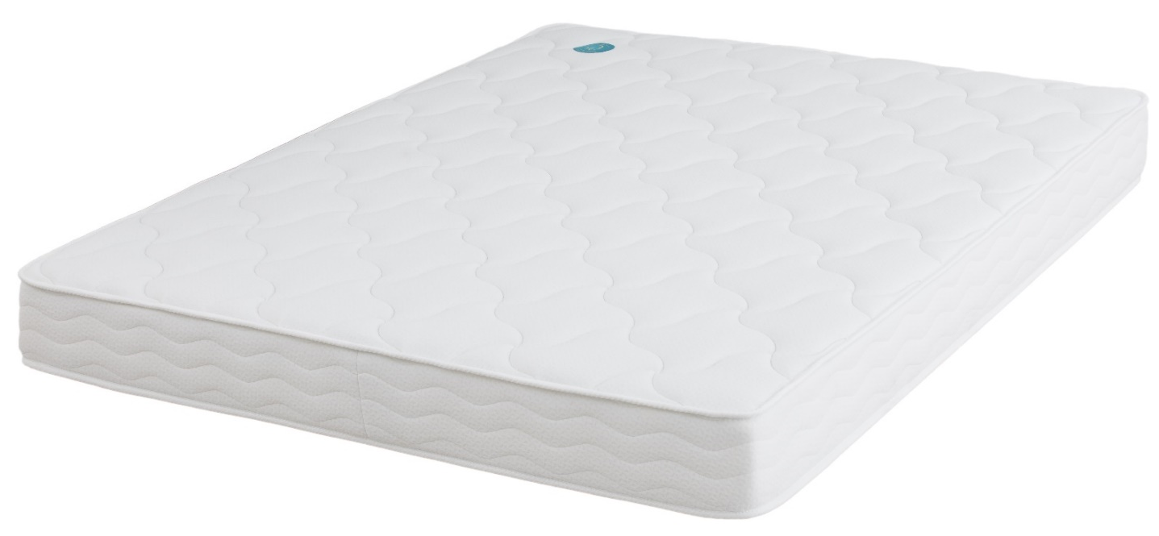
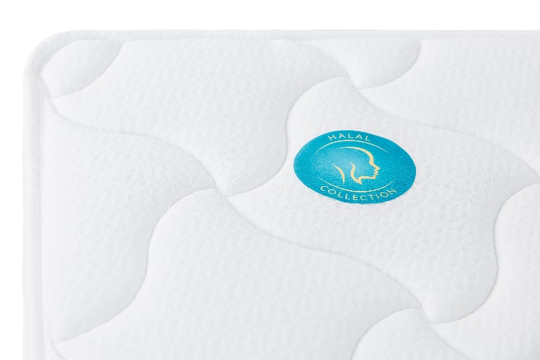
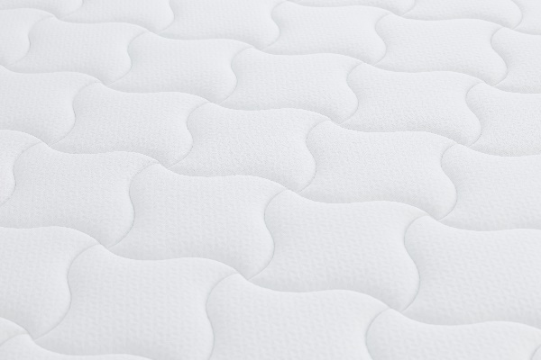
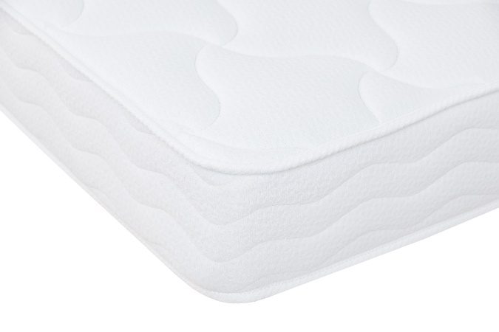
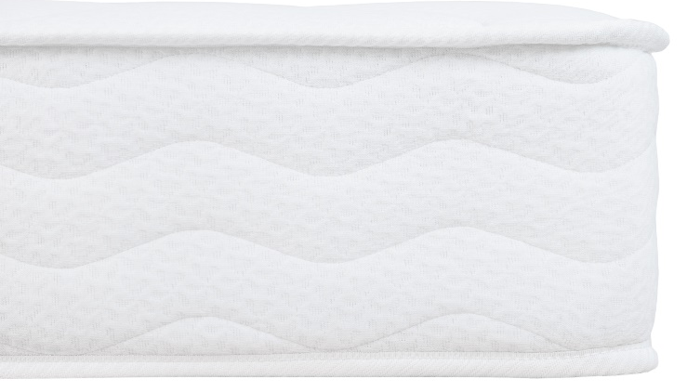
HALAL. Destek mattress appearance
Notes:
Ready

Slide 20
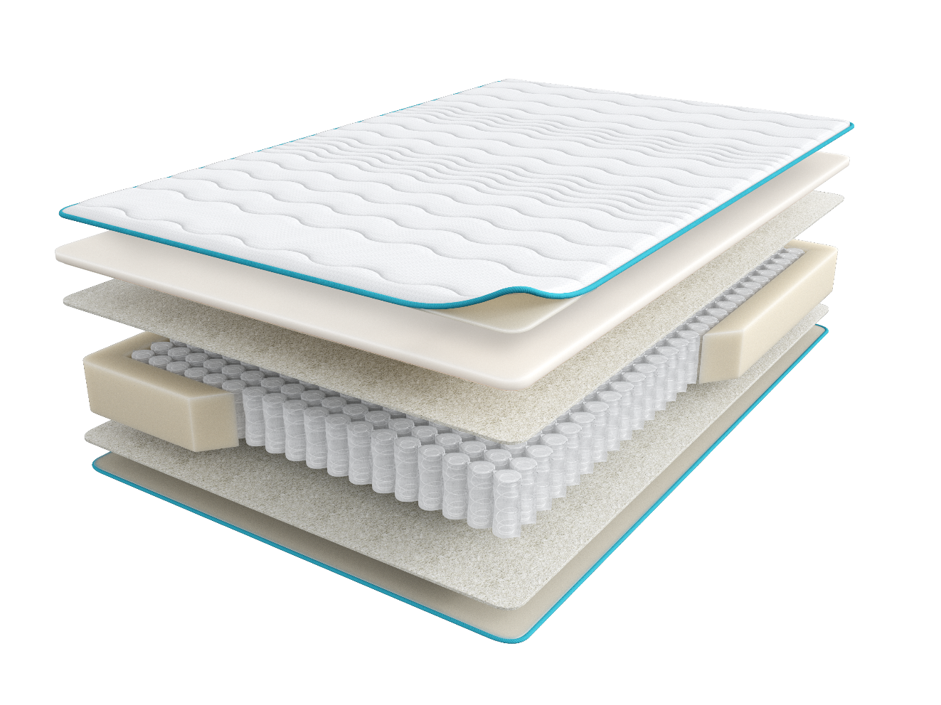
HALAL
NAYM Model
- sleep (Arabic)
ensures proper support of the spine during sleep and facilitates complete relaxation.
anatomicity
comfort
natural materials
1
Polyester fiber- and highly elastic foam-based padded bulky knitted fabric
Orto Foam
White felt
4. Pocket spring unit, h – 18 cm
5. White felt
6. Mattress edge reinforcement system
7. Polyester fiber-based padded jacquard
2
6
3
4
5
single-sided mattress
7
Height | Firmness | load | Warranty
23 cm | above medium | over 140 kg | 25 years

Slide 21
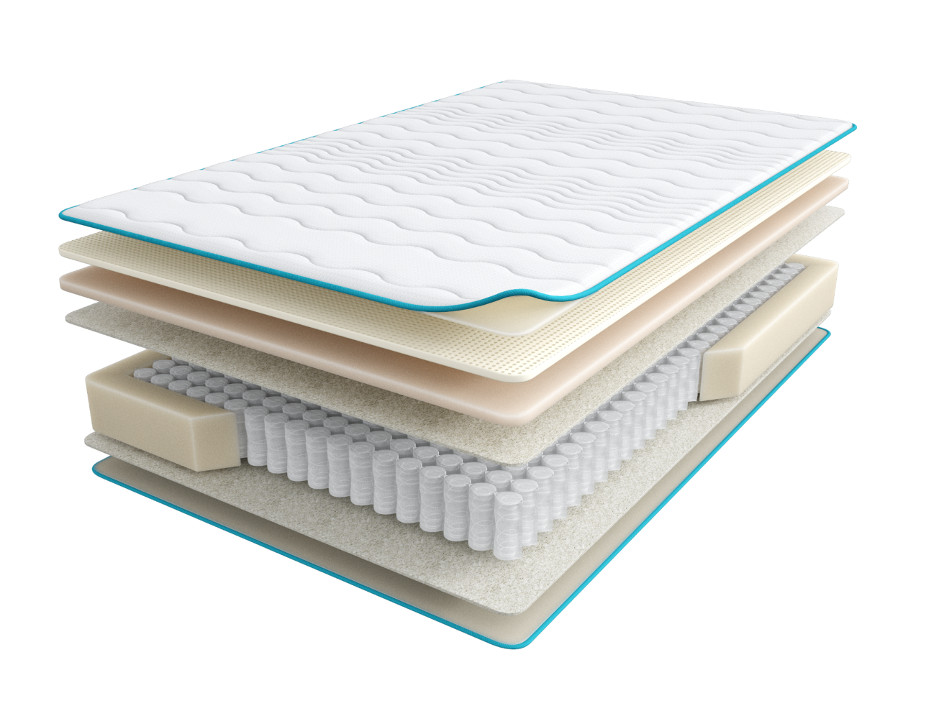
HALAL
BAKIM Model
- care (Turk.)
The mattress replenishes the body with vital energy. It contains natural latex that provides your sleep with bouncy support. Latex has a special, incredibly air-permeable structure that creates a well-balanced microclimate throughout the night
anatomicity
relaxation
comfort
edge reinforcement
natural materials
1
Polyester fiber- and highly elastic foam-based padded bulky knitted fabric
Natural latex
High-Density HR Foam
Linen fabric
5. Pocket spring unit, h – 18 cm
Linen fabric
Reinforced mattress edge support system increases the bedding area
Polyester fiber-based padded jacquard
2
7
3
4
5
single-sided mattress
6
8
Height | Firmness | load | Warranty
27 cm | high | over 140 kg | 25 years

Slide 22
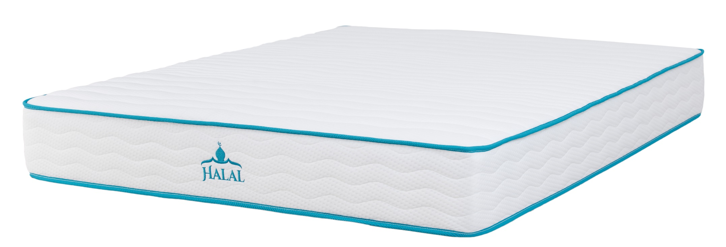
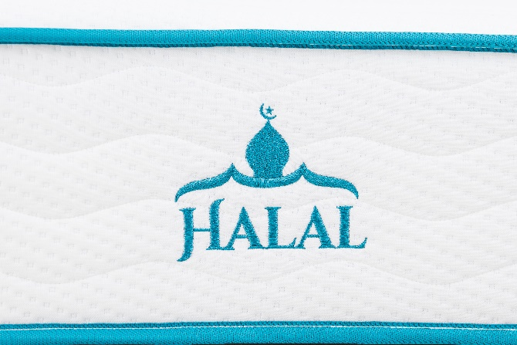
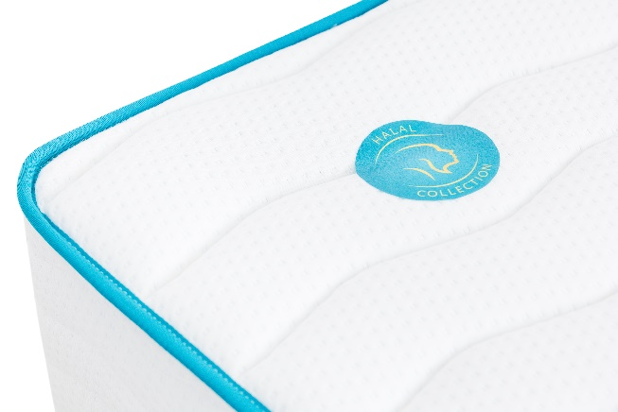
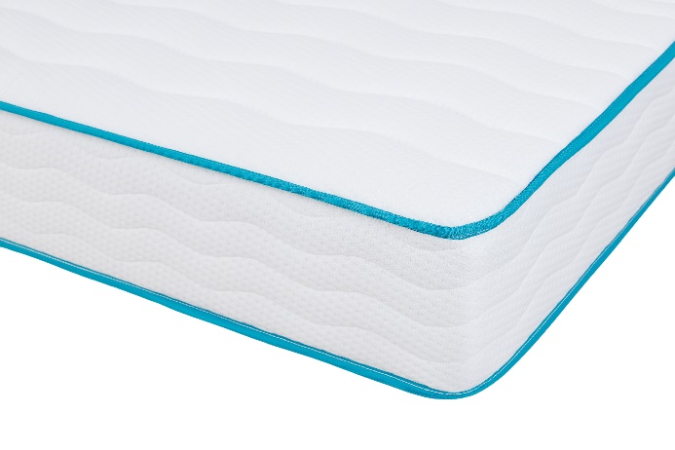
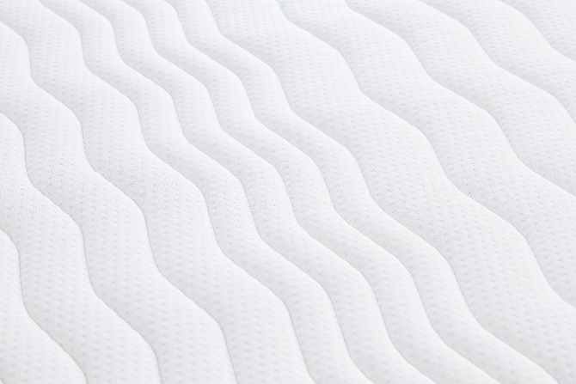
HALAL. Bakim и Naym mattress appearance
Notes:
Ready

Slide 23
HALAL. Mattress technical documentation
HALAL Certificate
The Certificate contains:
sleeping guide
mattress use manual
PRODUCT CERTIFICATE
The product is certified according to the Halal Voluntary Certification System
HALAL Label
The label is placed to the left of the mattress head and points at the location of a pillow.
Notes:
Ready

Slide 24
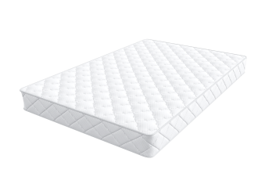
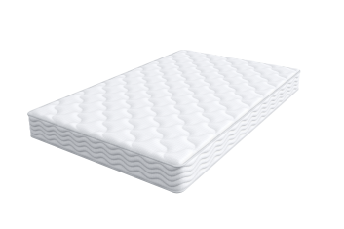
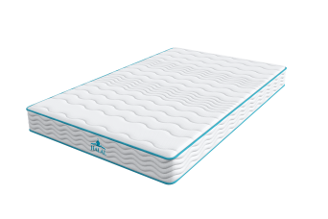
Summary
name | Dilek | Konfor | Destek | Naym | Bakim
appearance
height | 16 | 16 | 20 | 23 | 27
firmness | medium | above medium | high | above medium | high
warranty | 3 | 5 | 25 | 25 | 25
load | 90 | 110 | 140 | 140 | 140
spring unit | bonnel h-13 | pocket h-12 | pocket h-15 | pocket h-18 | pocket h-18
protection layer | white felt | white felt | white felt | white felt | linen
comfort layer | bi-coconut | Orto Foam | Orto Foam | Orto Foam | HR Foam latex
cover fabric | jacquard | jacquard | knitted fabric | bulky knitted fabric | bulky knitted fabric
bed sets | SM, bed grid, frame | SM, bed grid, frame | SM, bed grid, frame | SM, bed grid, frame | SM, bed grid, frame

Slide 25
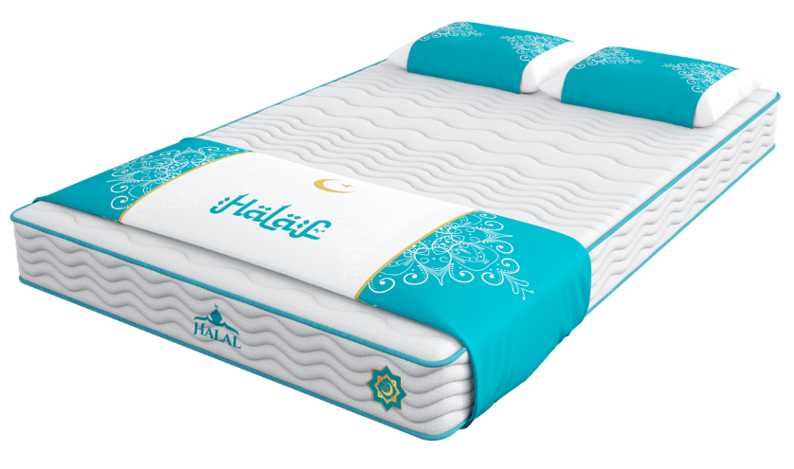
Halal set retail layout and arrangement tips
The following items are to be displayed:
Halal Bakim 200*160 Mattress – 1 pc.
Halal Naym 200*160 Mattress – 1 pc.
Decorative set of a Halal rug (240*47 cm) + 2 napkins (50*76 cm)
Decorative set of a Halal rug (260*47 cm) + 1 napkin (50*76 cm) (for the size of 200*080/090)
Halal Certificate Label
Decorative arrangement can be ordered via Design Department.
Attention! A decorative set doesn’t include pillows
The Halal Label is to be placed at the footboard of a mattress,
in the right corner, 20 cm from the edge, using a gun
342
Notes:
Ready

Slide 26
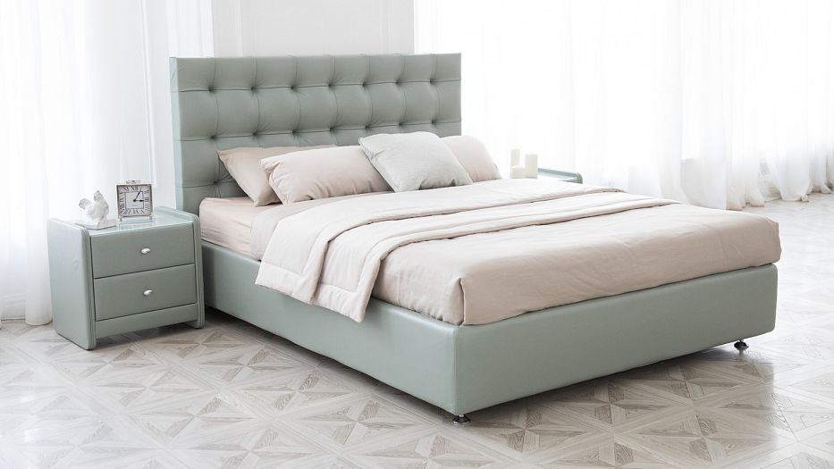
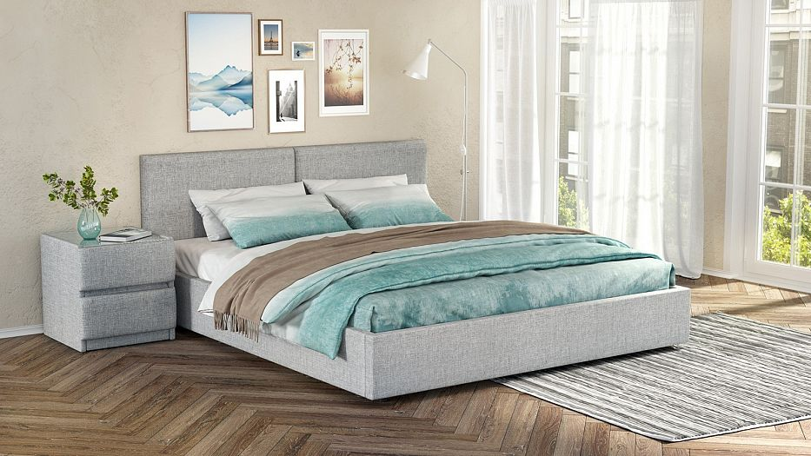
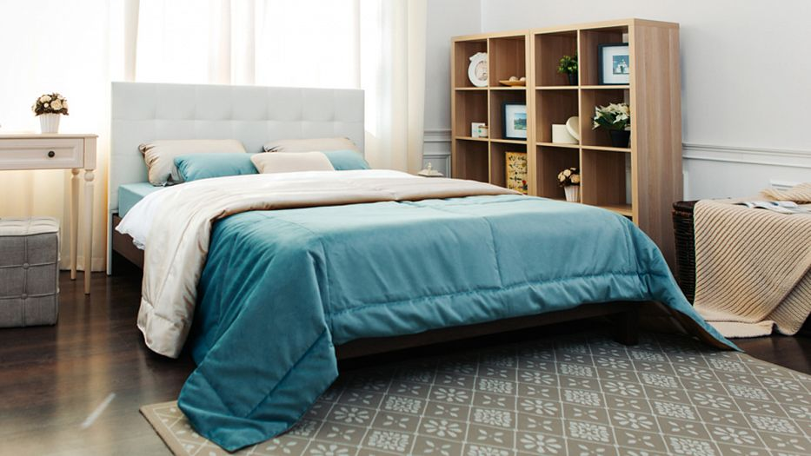
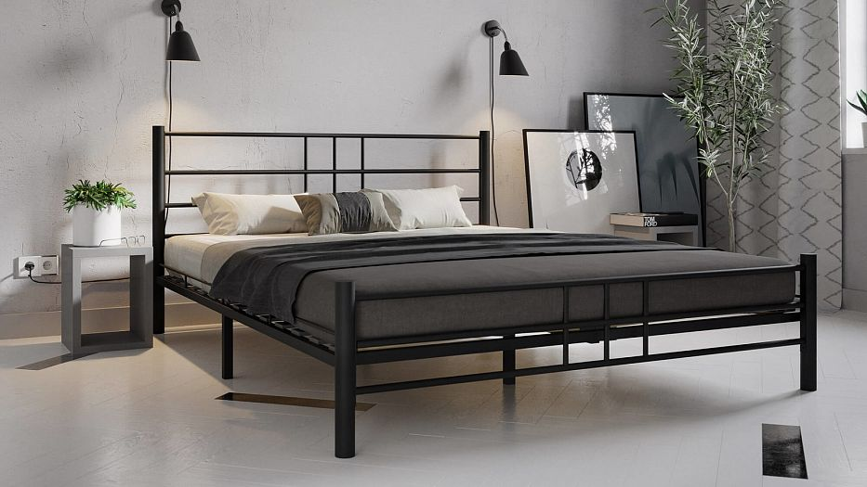
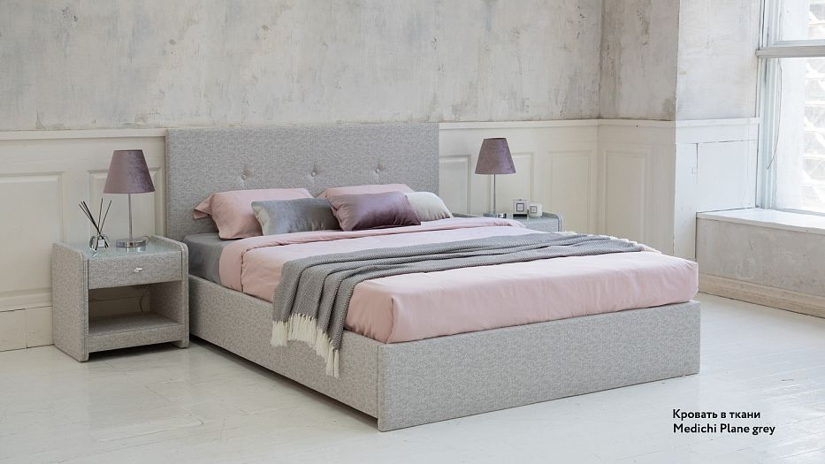
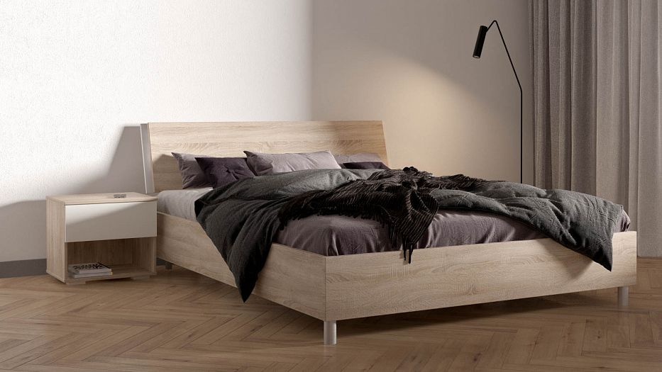
Recommendations for mattress arrangement on beds in the display
A mattress is to be “submerged” in a bed with closed subframes by no more than 2 cm
Color scheme: light hues, white
Styles: loft, minimalism, Nordic, chalet
Bed options below
342
Notes:
Ready

Slide 27
Product weight
Names of models | 200*080 | 200*090 | 200*120 | 200*140 | 200*160 | 200*180 | 200*200
 | weight (kg) | weight (kg) | weight (kg) | weight (kg) | weight (kg) | weight (kg) | weight (kg)
Bakim | 18.9 | 21.2 | 28.3 | 33 | 37.7 | 42.4 | 47.1
Naym | 14.8 | 16.6 | 22.1 | 25.8 | 29.5 | 33.2 | 36.9
Destek | 14.6 | 16.4 | 21.9 | 25.6 | 29.2 | 32.9 | 36.5
Dilek | 11.5 | 12.9 | 17.3 | 20.1 | 23 | 25.9 | 28.8
Konfor | 10.2 | 11.5 | 15.3 | 17.9 | 20.4 | 23 | 25.5
342
Notes:
Ready

Slide 28
Thank you for your attention!
www.askona.ru/sleeptolive

